Slide 1
HORIZON-INFRA-2026-DEV-01-02: Consolidation of the research infrastructure landscape – pilots for strategic coordination, synergies and simplified access pathways, by large thematic clusters of pan-European research infrastructures.
☺
ENVRI-ONE
We are the environmental cluster as one entity - one system, one interface, one voice.
First we made it FAIR, NEXT we developed it further, now we bring it together as ONE

Slide 2
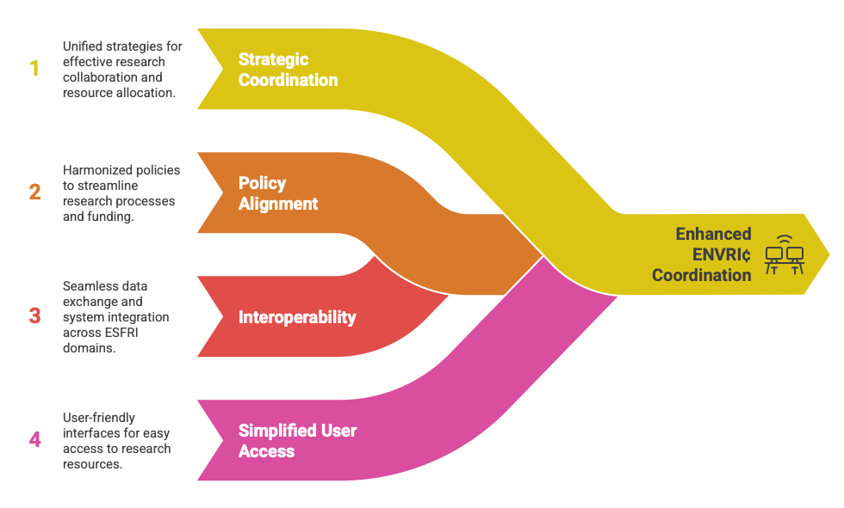
This call is the successor to the Horizon 2020 science clusters (ENVRI, PaNOSC, ESCAPE, EOSC-Life, SSHOC).
Now focused on strategic coordination, policy alignment, interoperability and simplified user access within each ESFRI domain.

Slide 3
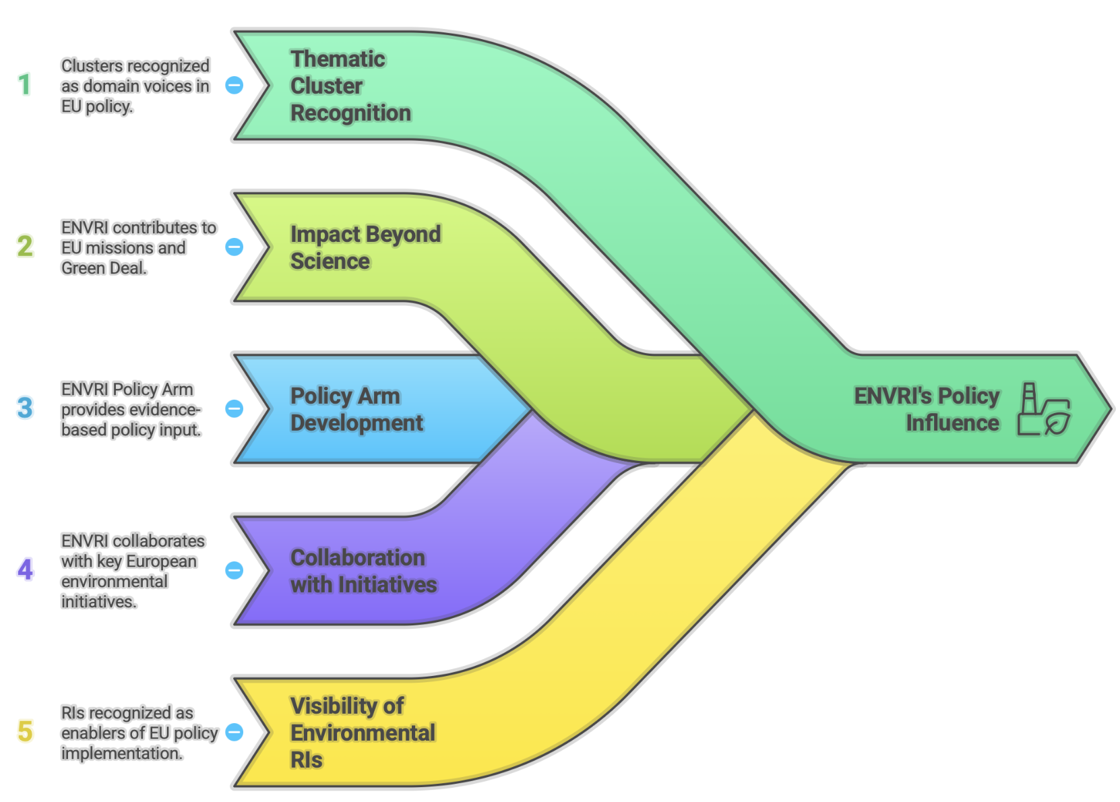
Expected results: 1.Policy contribution and visibility
Each thematic cluster becomes the recognised voice of its domain in EU and global policy discussions.
The cluster shows clear impact beyond science: contribution to EU missions, Green Deal, digital transition, etc.
Enhanced policy influence and stronger links with initiatives like EOSC, Copernicus, EuroGEO, Destination Earth, etc.
Notes:
Establishing ENVRI as the policy and coordination voice of the environmental research infrastructure (RI) domain in Europe.
Developing a structured ENVRI Policy Arm that provides evidence-based input to EU and global policies, including the European Green Deal, EU Missions, and Sustainable Development Goals (SDGs).
Producing policy briefs, position papers, and coordinated responses to EC consultations and ESFRI Roadmap updates.
Strengthening collaboration with ERIC Forum, EIROforum, EU Missions, Copernicus, EuroGEO, and Destination Earth, ensuring ENVRI’s scientific assets directly support European environmental priorities.
Increasing the visibility and recognition of environmental RIs (ICOS, ACTRIS, eLTER, EMSO, LifeWatch, etc.) as enablers of EUpolicy implementation.

Slide 4
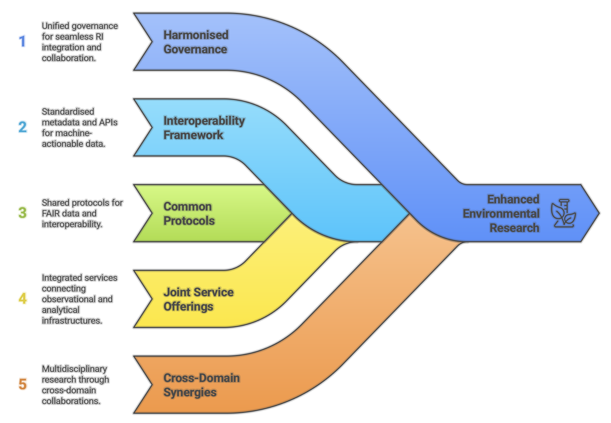
Expected results: 2. Improved coordination and integration
Better synergy, interoperability, and complementarity among RIs in the domain.
Avoid duplication, align services, and develop cross-RI interoperability (technical and organisational).
Foster cross-domain collaboration where relevant (e.g., ENVRI with energy or health clusters).
Notes:
Deepening the integration among ENVRI RIs through harmonised governance, technical standards, and access models.
Advancing the ENVRI Interoperability Framework, aligning metadata standards (e.g., ISO 19115, DCAT-AP, Schema.org) and APIs for machine-actionable data and services.
Developing common protocols and best practices for FAIR data, access policies, and cross-infrastructure interoperability.
Establishing joint service offerings and shared workflows that connect observational, experimental, and analytical infrastructures.
Fostering cross-domain synergies with other clusters (e.g., climate–health, environment–energy, and environment–social sciences) for multidisciplinary research

Slide 5
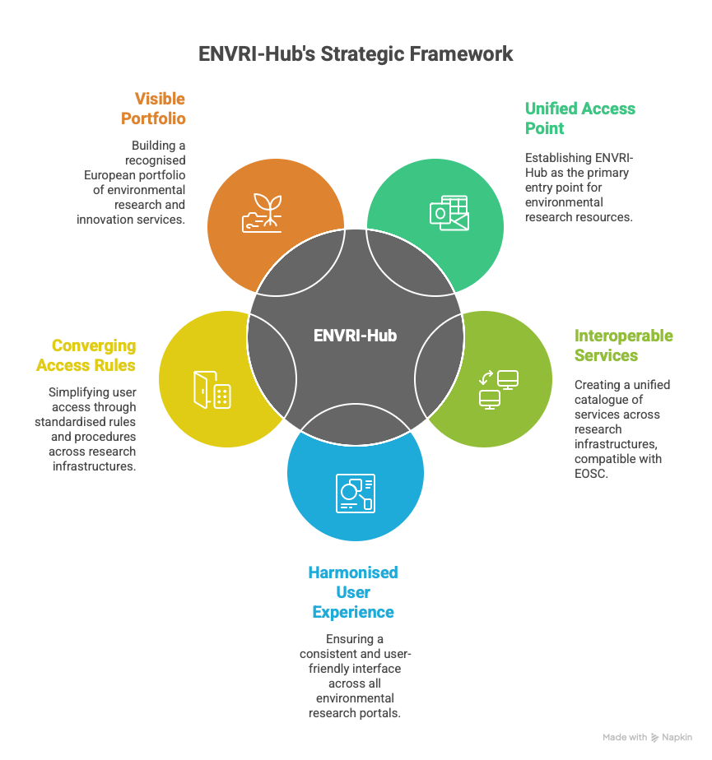
Expected results:3. European portfolio of R&I services
Build a common front page or single entry point for access to domain services (e.g., ENVRI-Hub as the single-entry portal).
Develop or connect catalogues of R&I services that are interoperable with EOSC and other European catalogues.
Harmonise access procedures and selection criteria.
Provide a coherent, visible European “offer” to users (researchers, innovators, public authorities, SMEs).
Notes:
Positioning ENVRI-Hub as the single-entry point for all environmental research infrastructures, offering integrated access to datasets, services, tools, and expertise.
Developing a unified catalogue of services across the ENVRI RIs, interoperable with EOSC and aligned with OSCARS’ federated access model.
Ensuring a common front page and harmonised user experience that makes environmental RIs findable, comparable, and accessible through one shared portal.
Defining converging access rules, workflows, and user selection procedures across RIs to simplify the user journey.
Building a visible, coherent European portfolio of environmental R&I services, recognised by policymakers, research communities, and industry alike.

Slide 6
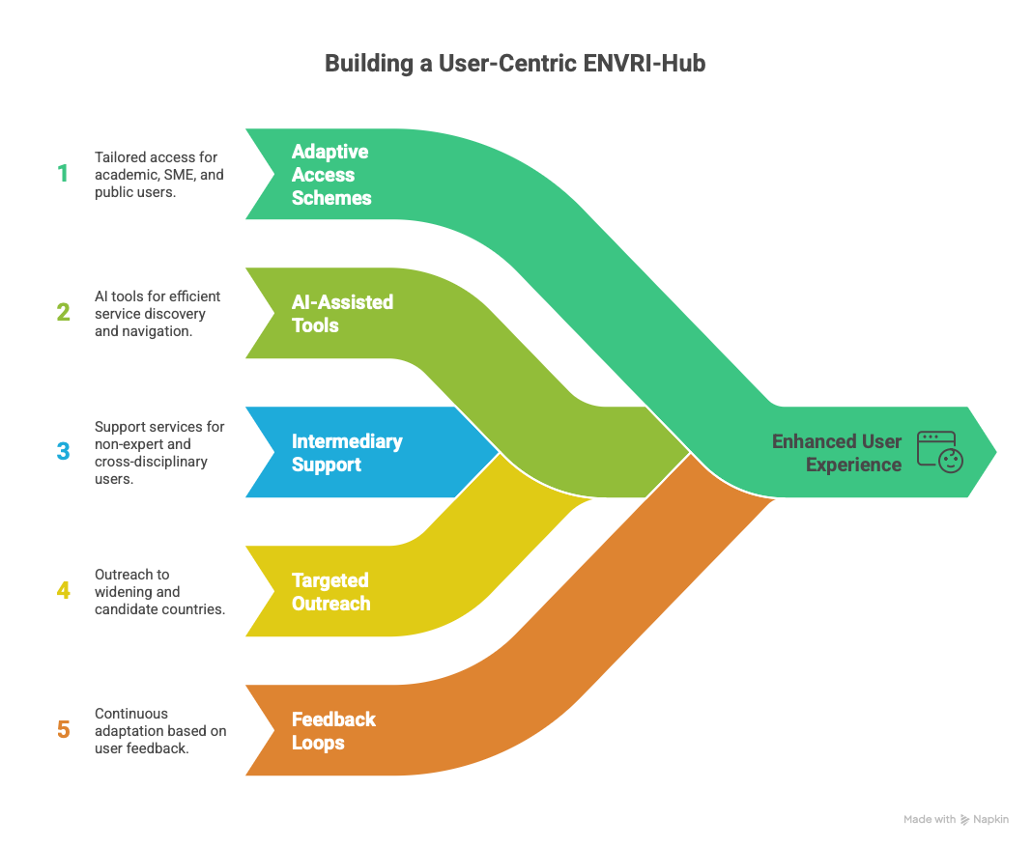
Expected results: 4. Simplified access pathways & increased awareness
Improve visibility and findability of RIs and their services.
Simplify access for new and non-traditional users: early-career researchers, widening countries, SMEs, public administrations, etc.
Develop AI-assisted navigation tools and intermediary services to help users discover the right RI services.
Strengthen user support and feedback mechanisms.
Notes:
Designing and testing simplified, adaptive access schemes tailored to different user communities:
academic researchers,
early-career scientists,
SMEs and startups,
public authorities, and
international programmes.
Developing AI-assisted discovery and navigation tools within ENVRI-Hub to help users identify relevant services efficiently.
Creating intermediary support services and helpdesk functions for non-expert and cross-disciplinary users.
Promoting ENVRI services through targeted outreach, training, and communication actions, especially in widening and candidate countries.
Enhancing feedback loops to continuously adapt services to emerging user needs.

Slide 7
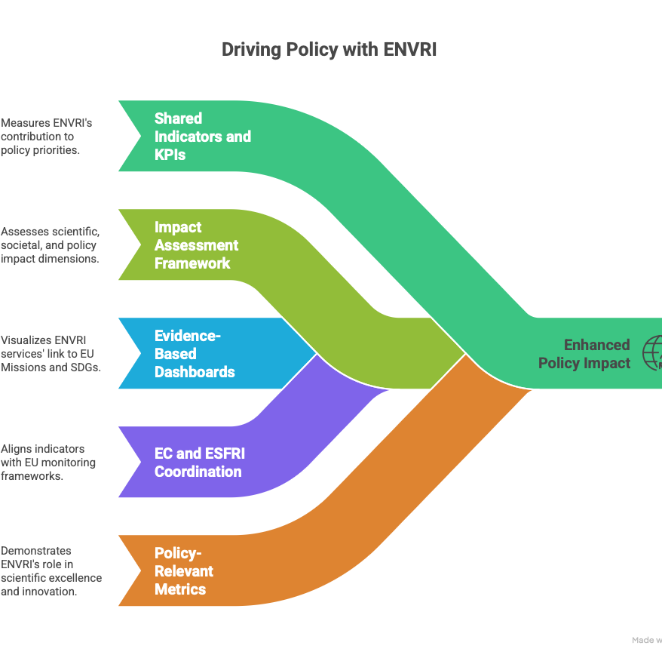
Expected results: 5. Indicators of strategic relevance
Develop indicators showing how specific RI services contribute to EU priorities (missions, partnerships, policy areas).
Coordinate impact assessments and validation mechanisms across infrastructures.
Notes:
Developing shared indicators and KPIs to measure the contribution of ENVRI RIs to European and global policy priorities.
Establishing a common impact assessment framework covering scientific, societal, and policy impact dimensions.
Producing evidence-based dashboards and visualisations linking ENVRI services to EU Missions (e.g., Climate Adaptation, Ocean, Soil), SDGs, and the Green Deal.
Coordinating with the EC and ESFRI to align these indicators with broader EU monitoring frameworks for RIs and EOSC.
Providing validated, policy-relevant metrics that demonstrate how ENVRI enables scientific excellence, innovation, and policy implementation.

Slide 8

Expected results: 6. Close coordination with related EU initiatives
  Ensure alignment and interoperability with:
    HORIZON-INFRA-2025-DEV-05 (preparatory action for integrated access schemes),
    HORIZON-INFRA-2027-SERV-01 & 02 (future access implementation pilots),
    ERIC Forum and EIROforum (cross-domain policy coordination),
    EOSC & OSCARS,
    Possibly JRC (for cross-domain collaboration, esp. environment–food–health links).
Notes:
Developing shared indicators and KPIs to measure the contribution of ENVRI RIs to European and global policy priorities.
Establishing a common impact assessment framework covering scientific, societal, and policy impact dimensions.
Producing evidence-based dashboards and visualisations linking ENVRI services to EU Missions (e.g., Climate Adaptation, Ocean, Soil), SDGs, and the Green Deal.
Coordinating with the EC and ESFRI to align these indicators with broader EU monitoring frameworks for RIs and EOSC.
Providing validated, policy-relevant metrics that demonstrate how ENVRI enables scientific excellence, innovation, and policy implementation.

Slide 9
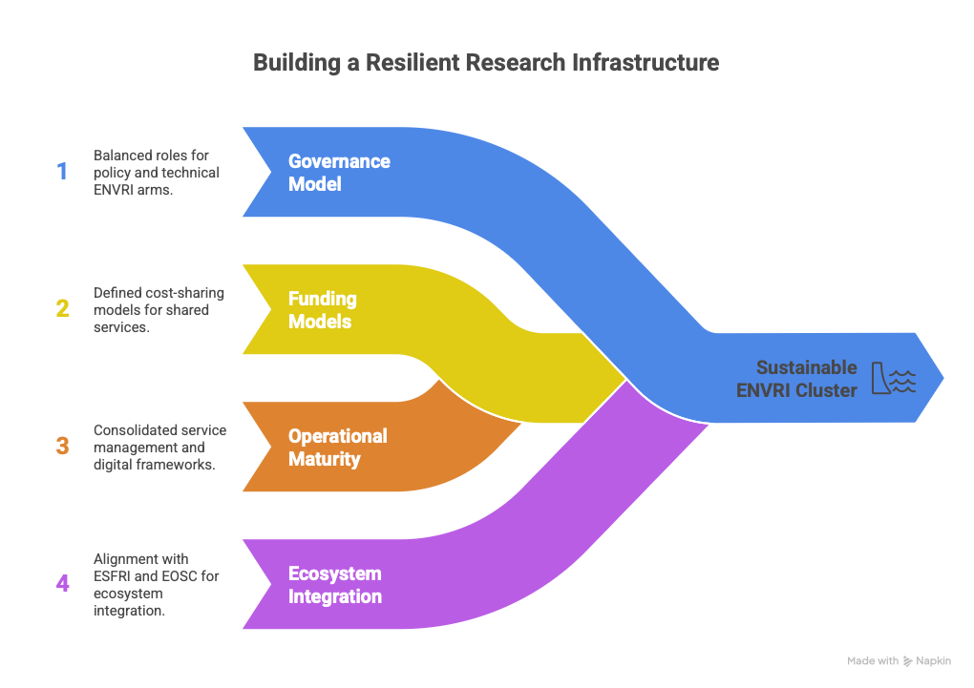
Strengthened sustainability and long-term governance
Not explicitly listed in the call text as a named expected result.
However, it is implied throughout the call’s scope and objectives, in several subtle but important ways.
it is absolutely aligned with the intent of the call.
Notes:
Building a sustainable governance model for the ENVRI cluster, balancing the roles of policy and technical arms (ENVRI Board, ENVRI-Hub, and related bodies).
Defining funding and cost-sharing models for shared services and infrastructures.
Enhancing operational maturity of ENVRI-Hub through consolidated service management, persistent identifiers, and trusted digital frameworks.
Positioning ENVRI as a permanent component of the European RI ecosystem, ready to evolve into a federated or ERIC-like structure aligned with ESFRI and EOSC.

Slide 10
From the call text: “Proposals should elaborate on which key EU priorities and initiatives (such as Horizon Europe partnerships, missions) they will consider and the nature and objectives of the envisaged coordination mechanisms or joint activities.”
EU Missions
Mission: Adaptation to Climate Change —
ENVRI RIs (ICOS, ANAEE, ACTRIS, eLTER, EPOS, etc.) provide essential observational and modelling data for assessing climate impacts, vulnerability, and resilience.
→ ENVRI can offer harmonised data services and indicators supporting Mission monitoring frameworks.
Mission: Restore Our Ocean and Waters —
Through e.g. ANAEE, EMSO, Euro-Argo, ICOS Ocean Thematic Centre, ENVRI provides marine, biogeochemical, and carbon flux observations.
→ Joint work on marine data interoperability, pollution tracking, and ocean carbon monitoring.
Mission: Soil Health and Food —
ANAEE, eLTER and LifeWatch deliver soil, biodiversity, and ecosystem data crucial for soil restoration and agroecological transition.
→ ENVRI can offer shared protocols and FAIR datasets for Mission demonstrators.
(Indirectly) Mission: Climate-Neutral and Smart Cities —
Urban air-quality and greenhouse-gas monitoring data from ICOS and ACTRIS support city-level climate actions.

Slide 11
Horizon Europe Partnerships
European Partnership for Environmental Observations (planned / under design) — natural fit; ENVRI can act as the backbone of the observation infrastructure component.
Partnership for Biodiversity (Biodiversa+) — collaboration via LifeWatch, ANAEE, eLTER, ICOS, and cross-data standards for ecosystem services.
Partnership for Climate Services (CSA / C3S interface) — linking ENVRI data streams to Copernicus Climate Services for policy-ready products.
Partnership for Ocean Research and Innovation (BlueMission / EuroMarine) — coordination via EMSO, Euro-Argo.
Partnership for Rescuing and Valorising Research Data (under EOSC / OSCARS) — align FAIRness and interoperability frameworks.
Partnership for agroecology – ANAEE; LIFEWATCH
Partnership for forestry –
…

Slide 12
EU Policy Frameworks
European Green Deal — overarching driver for all environmental RIs.
ENVRI provides data and services supporting climate neutrality, pollution monitoring, ecosystem restoration, and sustainable resource use.
Destination Earth (DestinE) — ENVRI observational data are fundamental for digital twins of the Earth system; collaboration with ECMWF and ESA is key.
Copernicus — ensure interoperability of ENVRI in-situ observations with Copernicus satellite data (especially via ICOS, ACTRIS, EMSO).
EuroGEO / GEO / WMO — strengthen Europe’s contribution to global Earth-observation systems.
EU Digital and Data Strategy / EOSC — ENVRI as a major data provider within the EOSC federated ecosystem.

Slide 13
Coordination Mechanism | Objective / Expected Result | Example Partners / Links
Policy-level coordination | Establish ENVRI Policy Forum with links to DG RTD, DG ENV, DG CLIMA, and Mission Secretariats. | Provide coordinated input from environmental RIs to EU policy processes and Mission implementation plans.
Data and service alignment | Harmonise ENVRI service catalogues and metadata with Copernicus, DestinE, and EOSC schemas. | Technical working groups between ICOS/ACTRIS/eLTER and ECMWF/ESA.
Joint pilots / demonstrators | Run co-designed pilots addressing specific EU policy goals (e.g., carbon cycle monitoring, biodiversity restoration). | Collaborations with Biodiversa+, EuroGEO, or JRC.
Shared indicators & reporting | Develop metrics showing ENVRI’s contribution to EU Missions and SDGs. | Linked dashboards with Mission secretariats or EC Mission Implementation Platforms.
Stakeholder engagement & communication | Co-organise policy workshops, Mission events, and stakeholder dialogues. | Joint sessions at EU Green Week, EOSC Symposium, EuroGEO, etc.
The EC expects to describe how ENVRI will interface with these initiatives, not just conceptually, but practically.
Example here:

Slide 14
ENVRI-Hub NEXT → builds the tools
ENVRI EOSC Node → connects them to EOSC
HORIZON-INFRA-2026-DEV-01-02 → unifies policy, governance, and physical, remote and virtual access at the European level.
Proposal to:
  Limit the consortium partners to core ENVRI landmarks
  Limit the number of beneficiaries per ENVRI;
  Include a way to engage the ESFRI projects, current and potential new ones
ACTRIS
AnaEE
DANUBIUS
EMBRC
EISCAT_3D
EMSO ERIC
EPOS ERIC
EURO-ARGO ERIC
EUROFLEETS
IAGOS
ICOS ERIC
LifeWatch ERIC
SEADATANET
SIOS
EGI – ENVRI-Hub NEXT and EOSC
This project will run in parallel and full complementarity with ENVRI-Hub NEXT (which develops the technical integration and innovation framework) and the ENVRI EOSC Node (which ensures the operational connection to EOSC). Building on these foundations, the new project will consolidate the technical components developed under previous ENVRI initiatives and provide the missing strategic coordination and policy layer of the environmental research infrastructure cluster.

